Slide 1
Lecture 5
Premixed Turbulent Combustion:
The Regime Diagram
11.-1

Slide 2
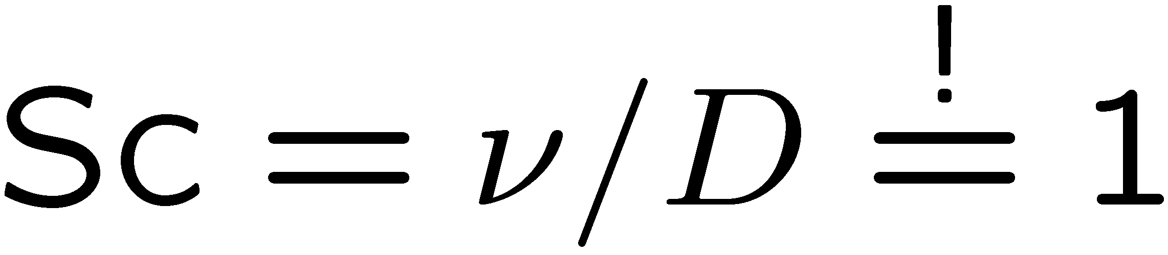
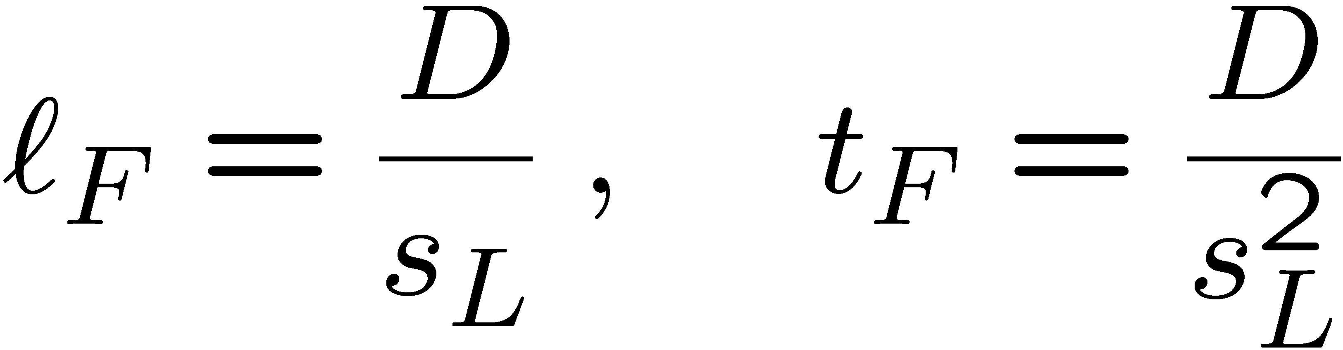
Regimes in Premixed Turbulent Combustion
Diagrams defining regimes of premixed turbulent combustion in terms of velocity and length scale ratios have been proposed by Borghi (1985), Peters (1986),
Abdel-Gayed and Brandley (1989), Poinsot et al. (1990) and many others.
For scaling purposes it is useful to assume equal diffusivities for all reactive scalars, a Schmidt number of unity
and to define the flame thickness and the flame time as
11.-2

Slide 3
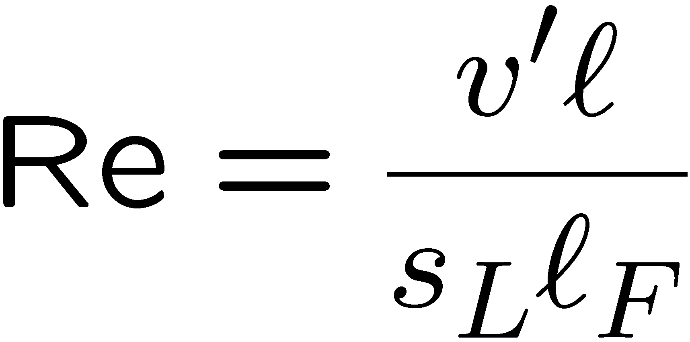
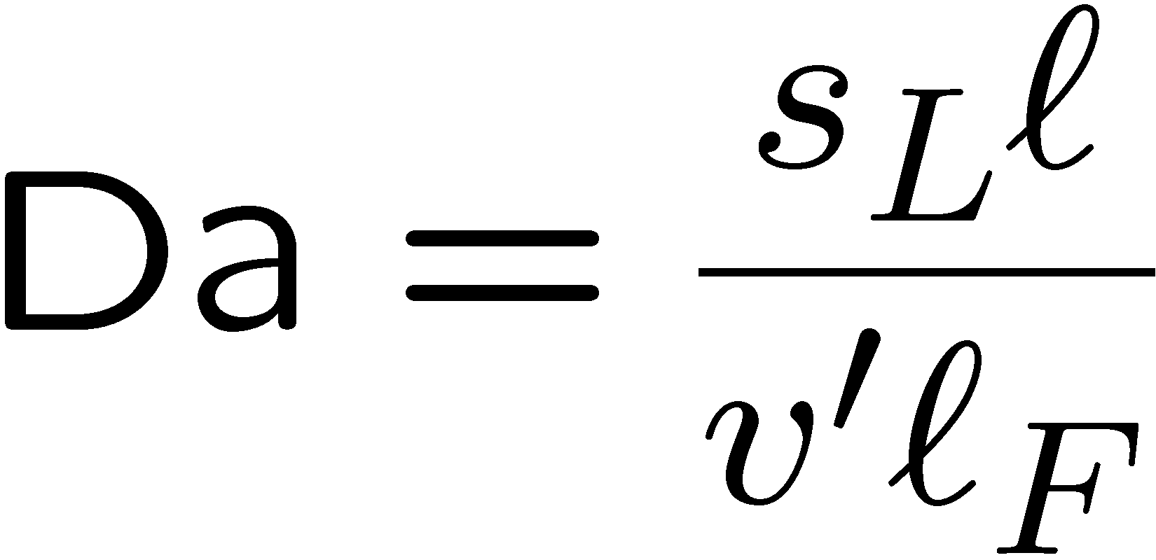
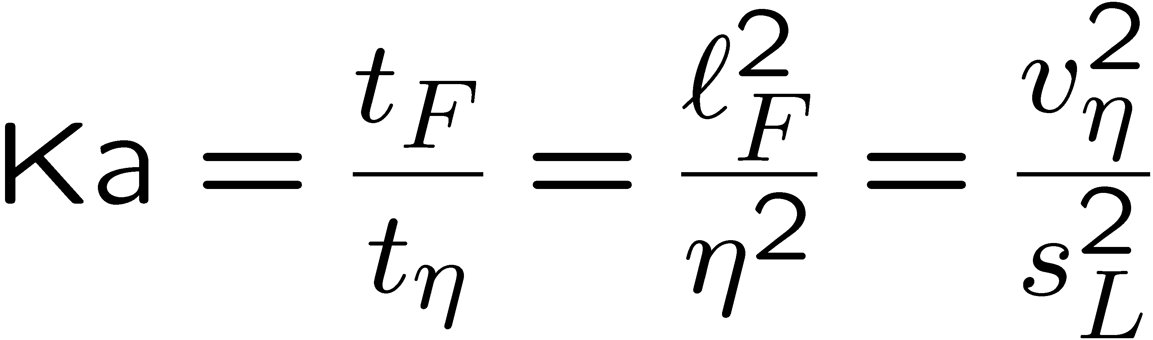
Then, using ν = D, the turbulent intensity and the turbulent length scale introduced in Lecture 10, we define the turbulent Reynolds number as
and the turbulent Damköhler number
Furthermore, with the Kolmogorov time, length, and velocity scales defined in
Lecture 10, we introduce two turbulent Karlovitz numbers.
The first one defined as
measures the ratios of the flame scales in terms of the Kolmogorov scales.
11.-3

Slide 4
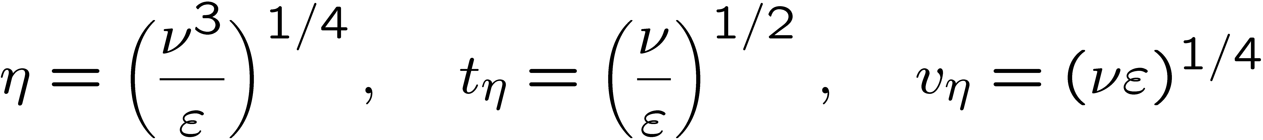
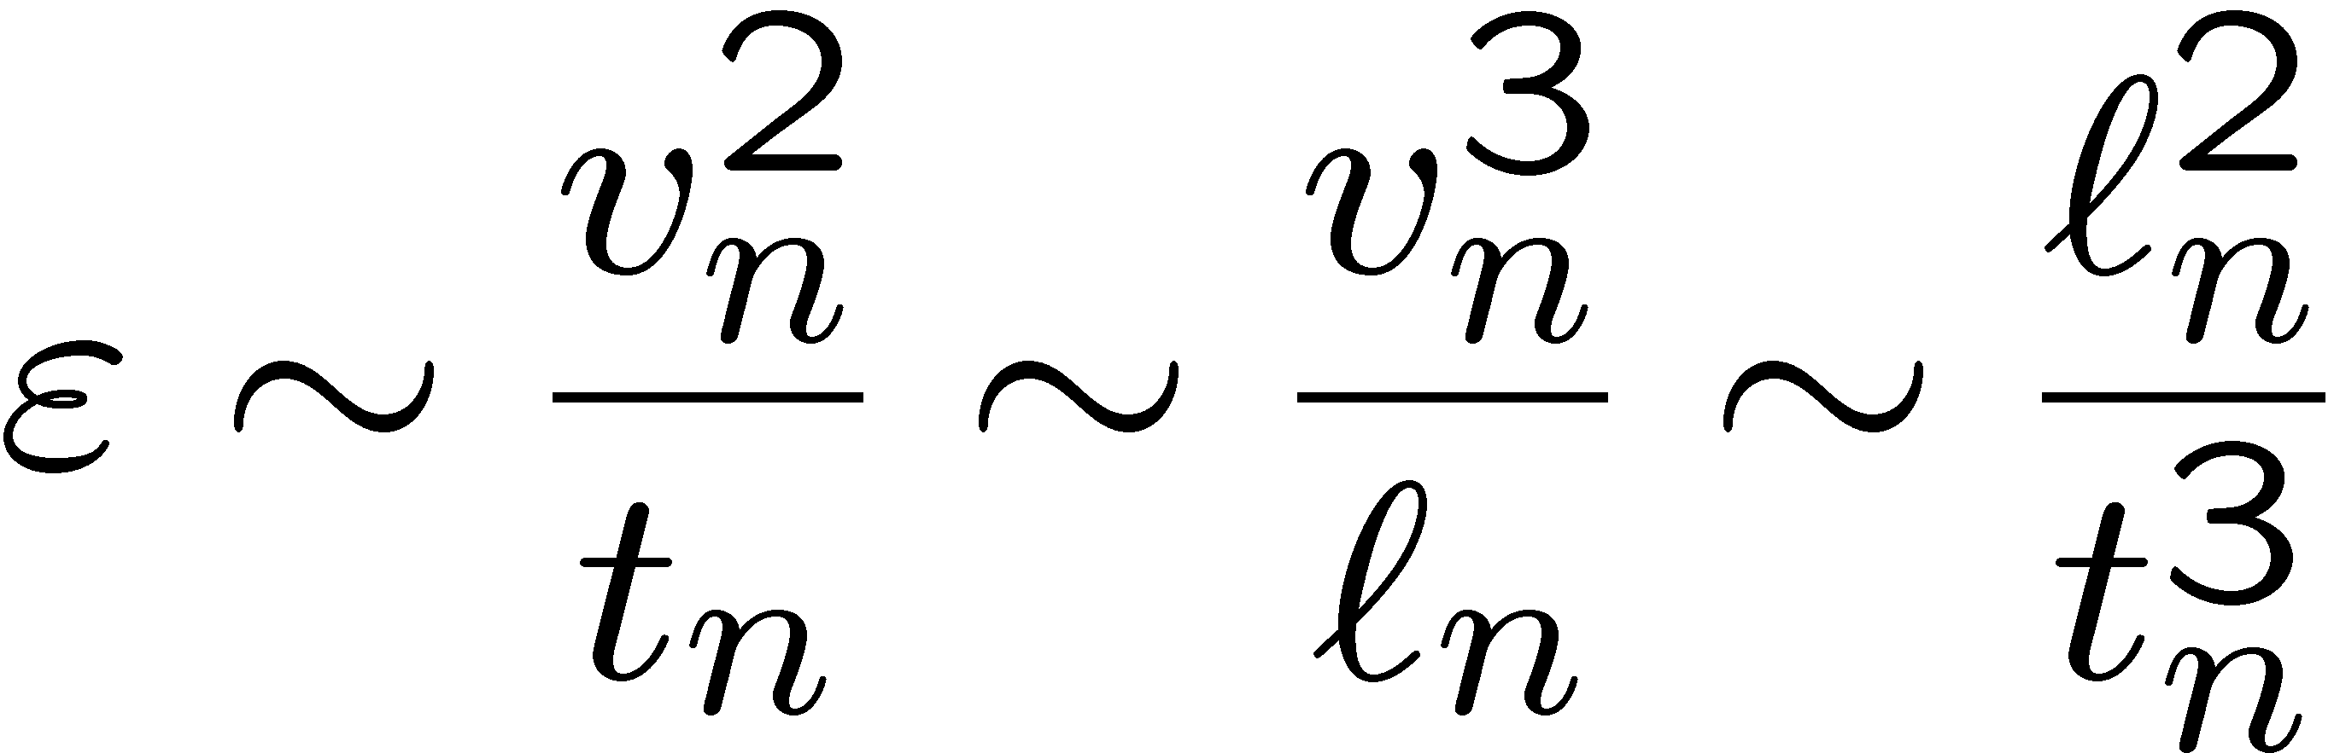
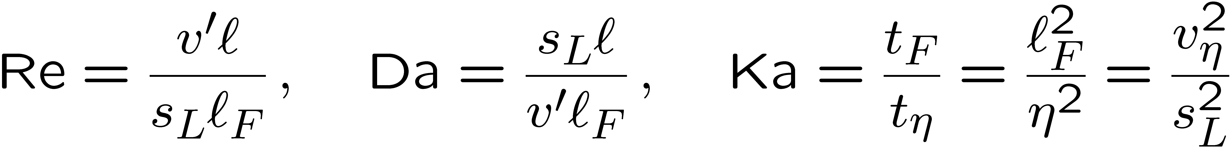
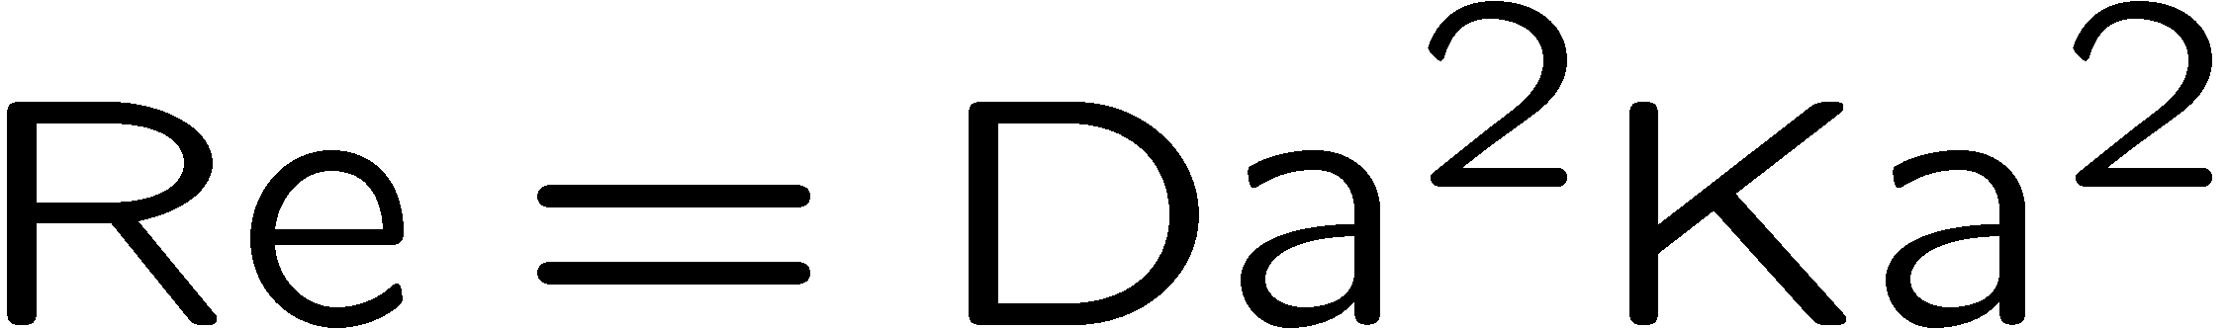
Using the definitions
with ν = D and
taken as equality it is seen that
can be combined to show that
11.-4

Slide 5
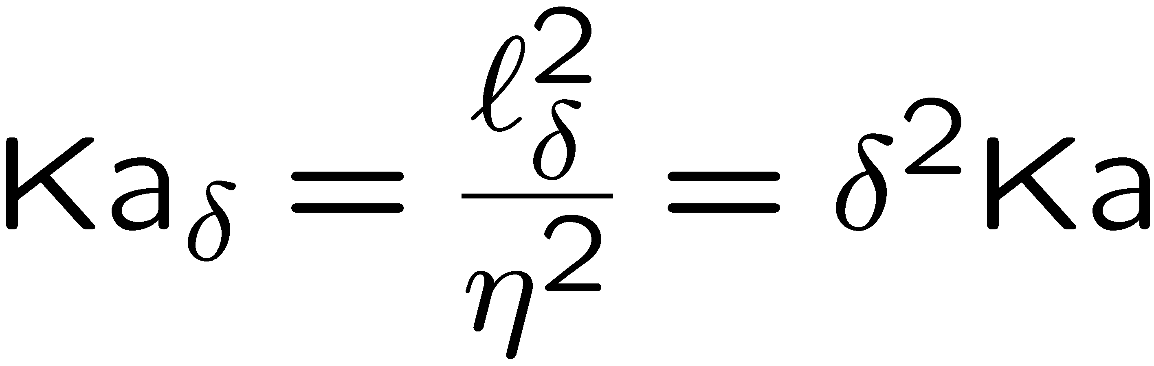
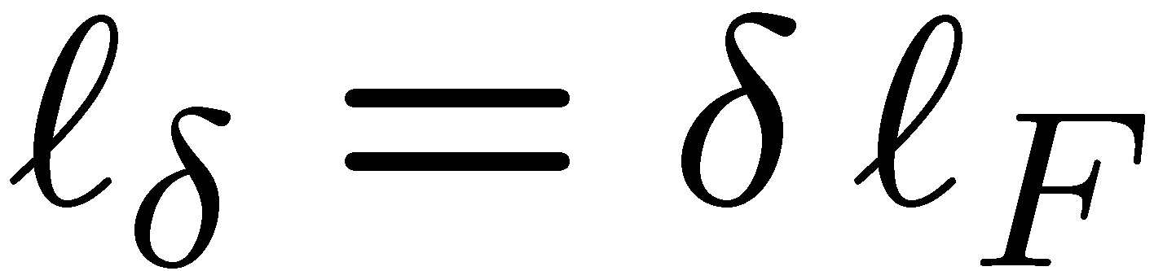
Referring to the discussion about the appropriate reaction zone thickness δ in two-steps premixed flames in Lecture 6, a second Karlovitz number Ka_{δ} may be introduced as
where for the reaction zone thickness
has been used.
11.-5

Slide 6
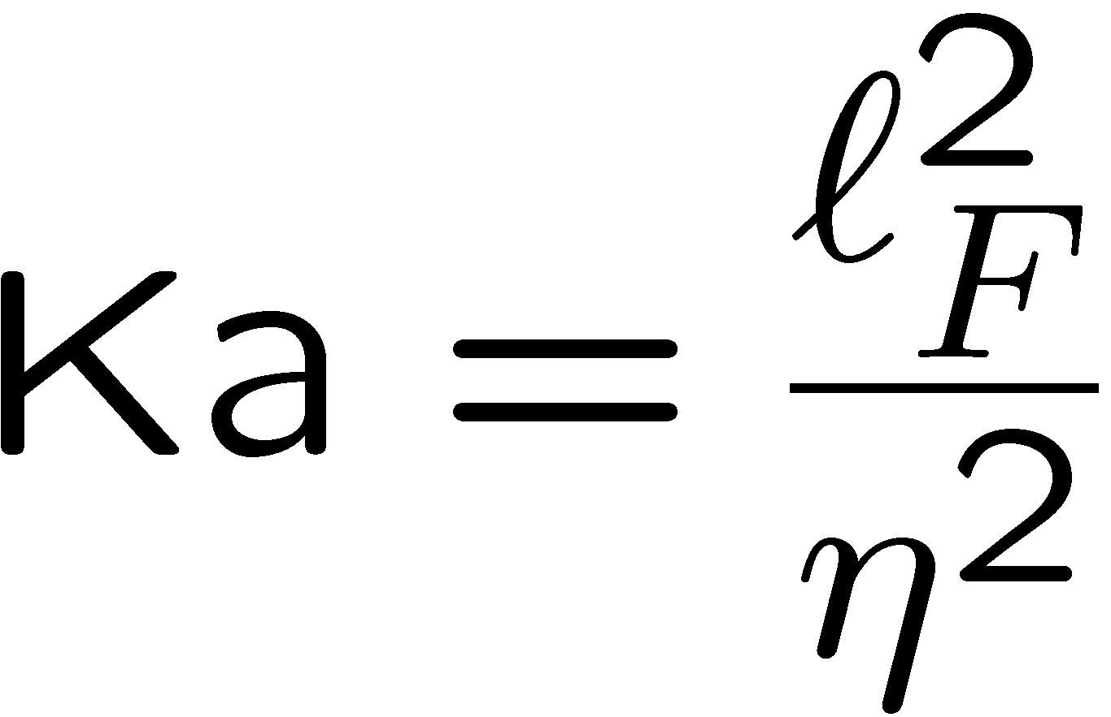
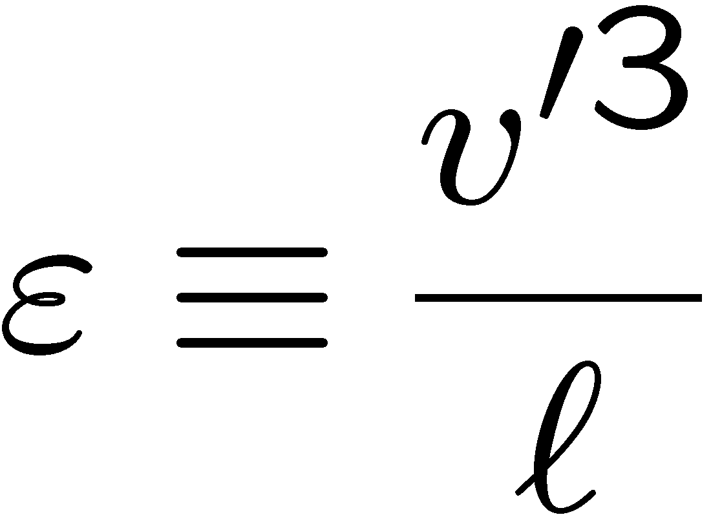
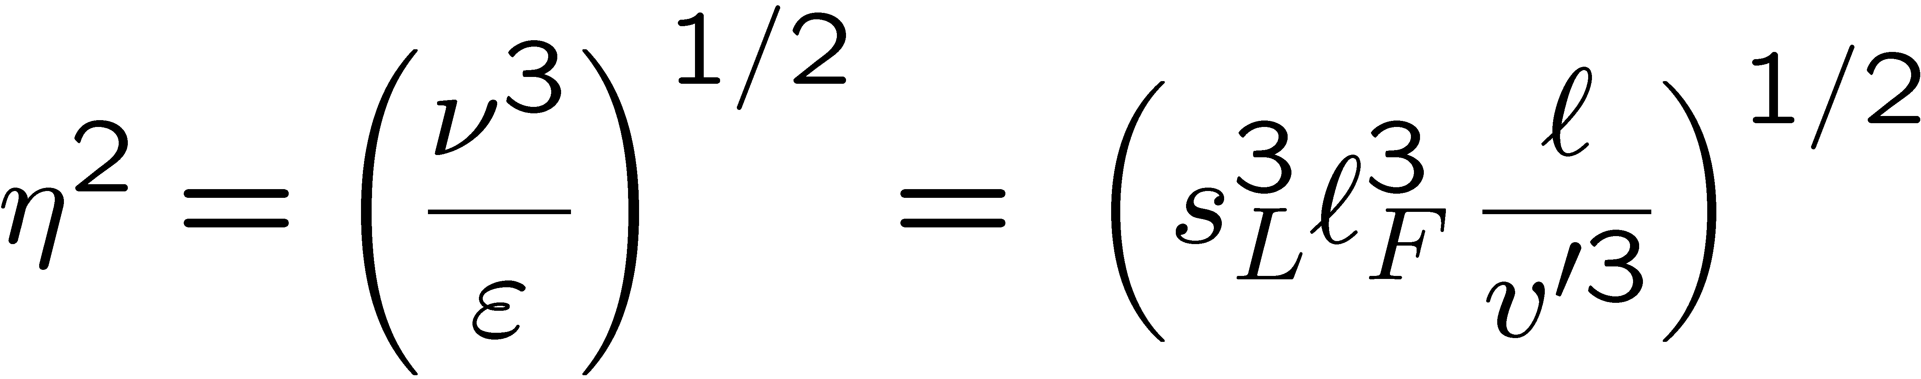
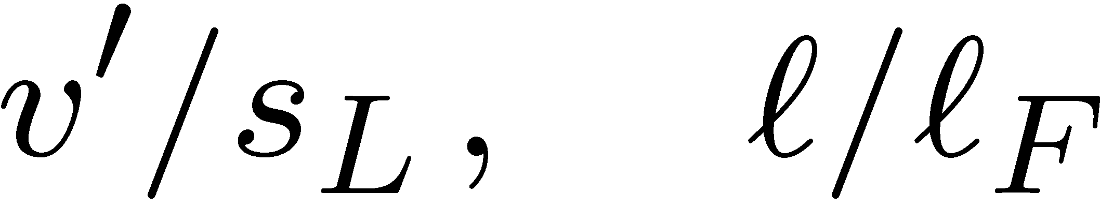
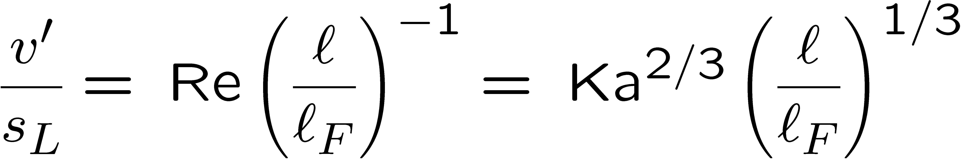
Regime diagram for premixed turbulent combustion
Using
and
where for scaling purposes we have set , such that the
Kolmogorov length scale squared becomes
the ratios may be expressed in terms of Re and Ka as
11.-6

Slide 7
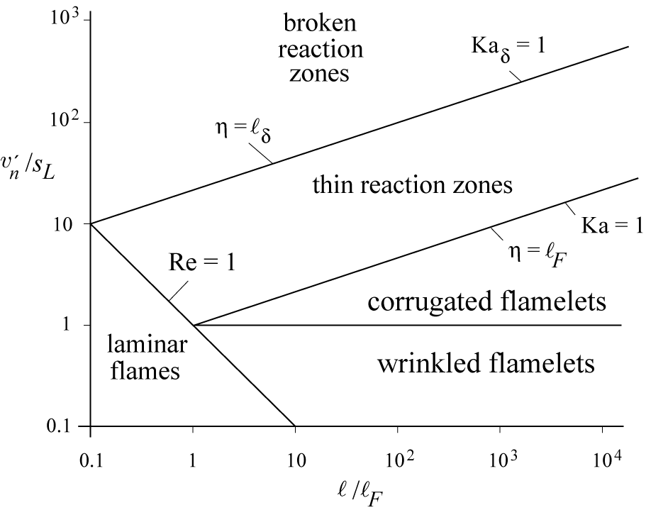
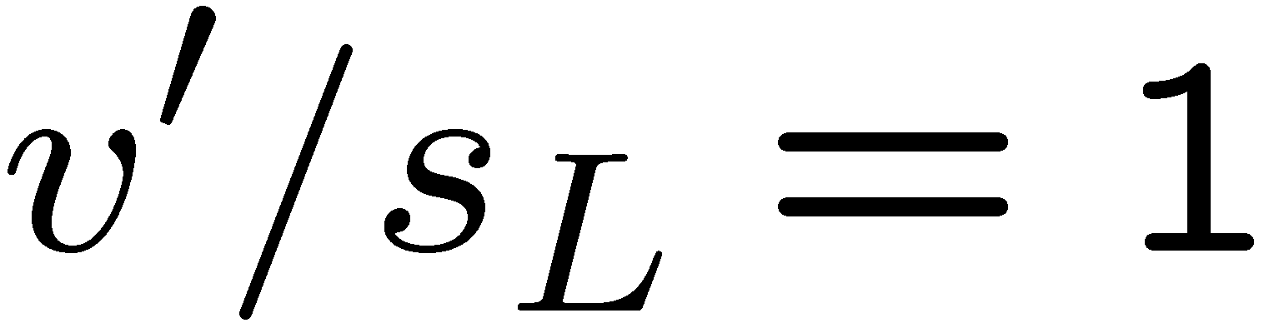
Regime diagram for premixed turbulent combustion
Using these relations the
lines Re = 1, Ka = 1
represent boundaries between
different regimes of premixed
turbulent combustion.
Other boundaries of interest are
the line
which separates the
wrinkled flamelets from the corrugated flamelets, and the line denoted by
Ka_{δ}=1, which separates thin reaction zones from broken reaction zones.
11.-7

Slide 8
Regime diagram for premixed turbulent combustion
The line Re = 1 separates all
turbulent flame regimes
Characterized by Re > 1
from the regime of
laminar flames (Re < 1),
which is situated in the
lower-left corner of the diagram.
We will consider
turbulent combustion for
large Reynolds numbers, which corresponds to a region sufficiently removed from the line Re = 1 towards the upper r.h.s.
11.-8

Slide 9
Regime diagram for premixed turbulent combustion
We will not consider the
wrinkled flamelet regime,
because it is not of much
practical interest.
In that regime, where v' < s_{L},
the turn-over velocity v' of
even the large eddies is not
large enough to compete with
the advancement of the
flame front with the laminar burning velocity s_{L}. Laminar flame propagation
therefore is dominating over flame front corrugations by turbulence.
11.-9

Slide 10
Regime diagram for premixed turbulent combustion
We will also not consider
the broken reaction zones
Regime in any detail for
reasons to be discussed at
the end of this lecture.
Among the remaining two
regimes, the
corrugated flamelets regime
is characterized by the inequalities
v’ > s_{L}, Re > 1 and Ka_{δ} < 1.
11.-10

Slide 11
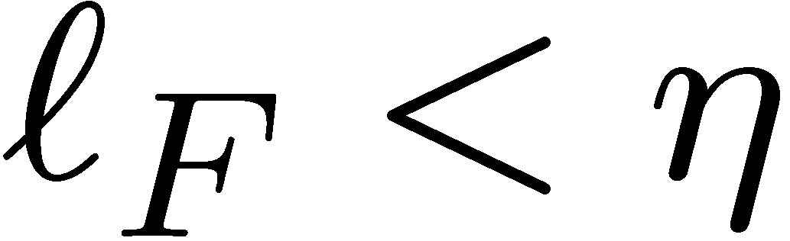
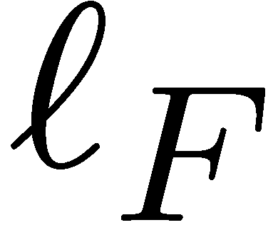
The corrugated flamelet regime
In view of
the Ka < 1 indicates that
which means that the entire
reactive-diffusive flame structure
of thickness is embedded within eddies of the size of the Kolmogorov scale, where the flow is quasi-laminar.
11.-11

Slide 12
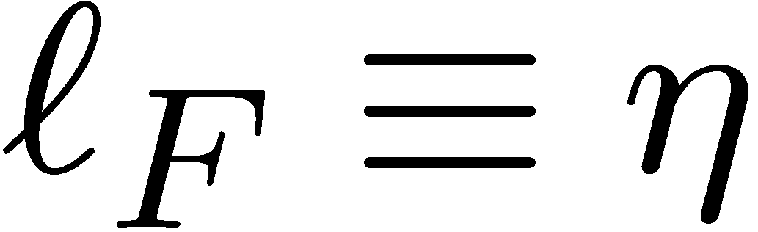
The corrugated flamelet regime
Therefore the flame structure
is not perturbed by turbulent
fluctuations and remains
quasi-steady.
The boundary of the
corrugated flamelets regime
to the thin reaction zones regime
is given by Ka = 1, which,
according to
is equivalent to the condition that the flame thickness is equal to the Kolmogorov length scale. This is called the Klimov-Williams criterion.
11.-12

Slide 13
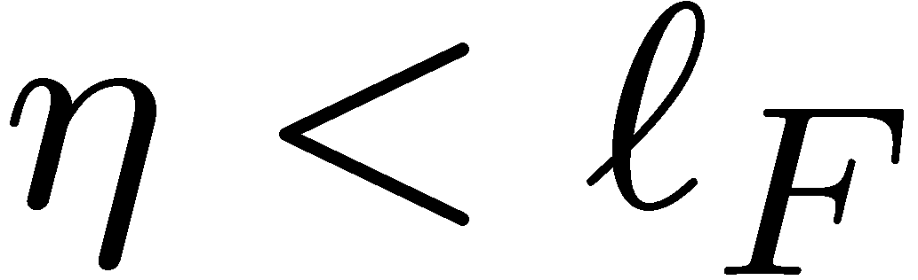
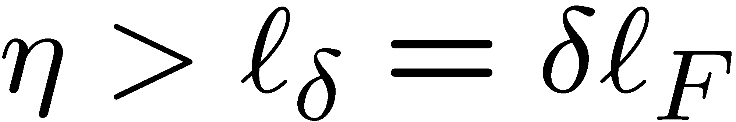
The thin reaction zones regime is characterized by Re > 1, Ka_{δ} < 1, and Ka >1.
Ka >1 indicates that the smallest eddies of size η can enter into the reactive-diffusive flame structure since
These small eddies are still larger than the inner layer thickness
and can therefore not penetrate into that layer.
11.-13

Slide 14
The non-dimensional thickness δ of the inner layer in a premixed flame is typically one tenth.
Therefore the inner layer thickness is one tenth of the preheat zone thickness, which is of the same order of magnitude as the flame thickness.
Using
we see that the line Ka_{δ} = 1 corresponds with δ = 0.1 to Ka=100.
11.-14

Slide 15
This value is used for the upper limit of the thin reaction zones regime.
It seems roughly to agree
with the flamelet boundary
obtained in numerical studies,
where 2D interactions between
a laminar premixed flame front
and a vortex pair were analyzed
Poinsot (1991).
These simulations correspond to
Ka=180 for cases without heat loss
and Ka=25 with small heat loss. The authors argued that since quenching by vortices occurs only for larger Karlovitz numbers, the region below the limiting value of the Karlovitz number should correspond to the flamelet regime.
11.-15

Slide 16
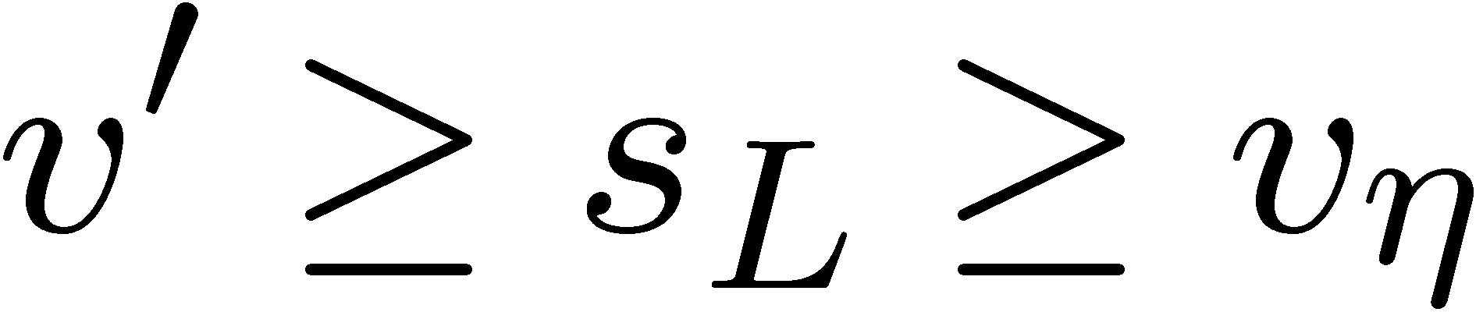
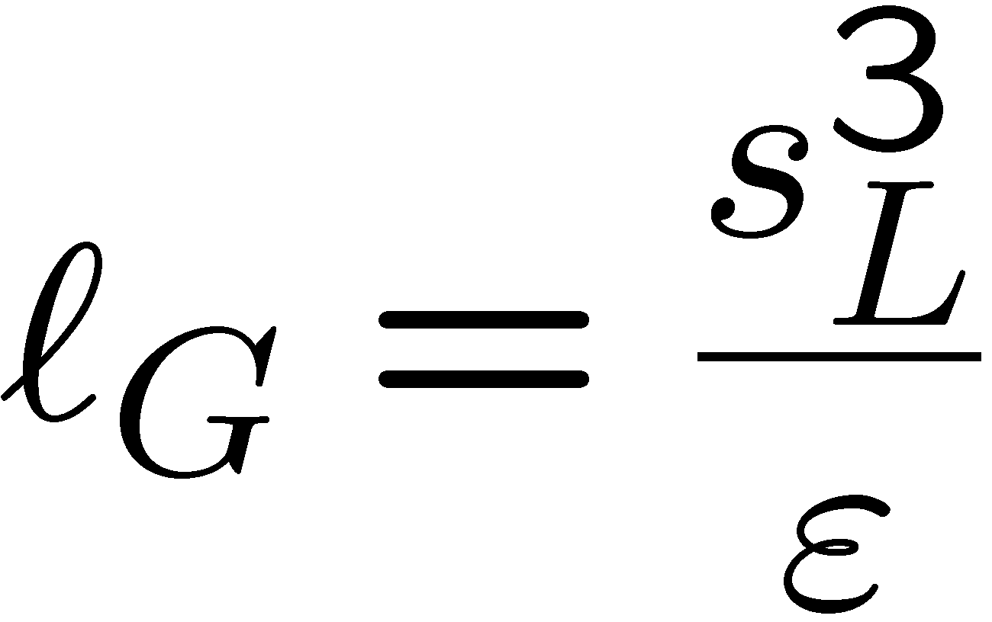
We will now enter into a more detailed discussion of the two flamelet regimes.
In the regime of corrugated flamelets there is a kinematic interaction
between turbulent eddies and the advancing quasi-laminar flame structure.
With Ka < 1 we have:
To determine the size of the eddy that interacts locally with the flame front, we set the turn-over velocity v_{n} = s_{L} in
This determines the the Gibson scale (cf. Peters ,1986) as
11.-16

Slide 17
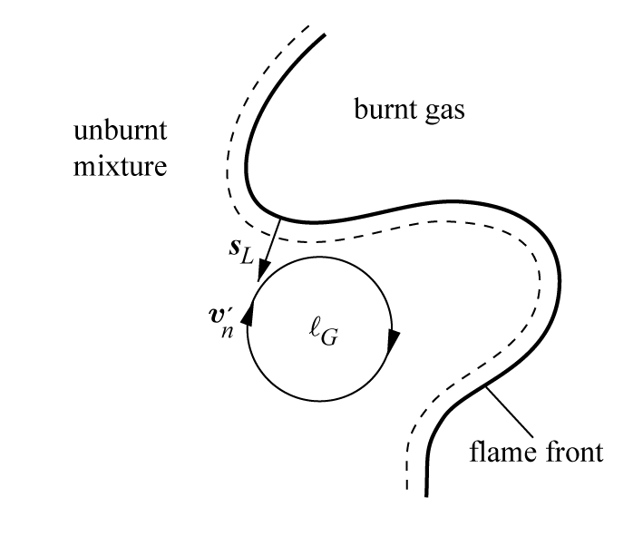
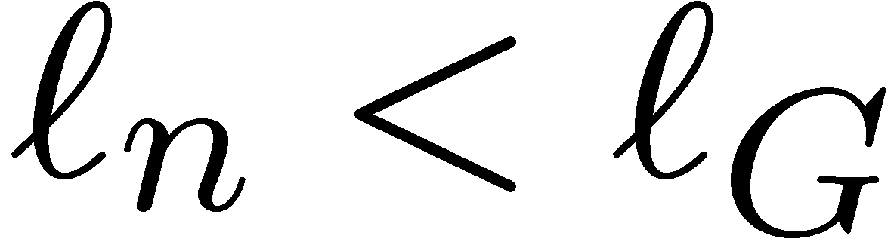
Eddies of the size of the Gibson scale
which have a turnover velocity v_{n} = s_{L}
can interact with the flame front.
Since the turn-over velocity of the
large eddies is larger than the
laminar burning velocity, these eddies will push
the flame front around, causing a substantial corrugation.
Smaller eddies of size having a turnover velocity smaller than s_{L} will not even be able to wrinkle the flame front.
11.-17

Slide 18
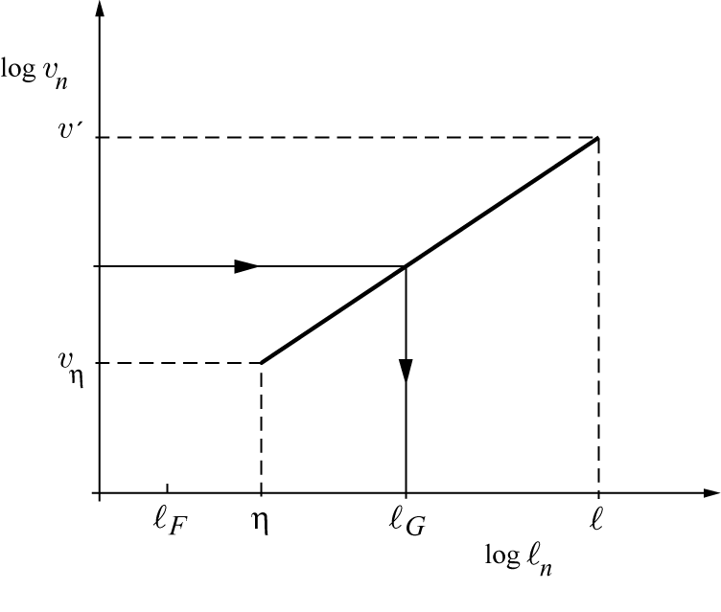
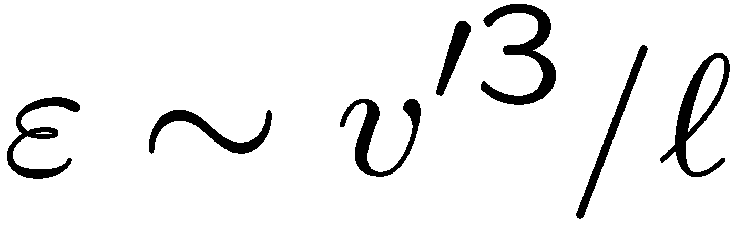
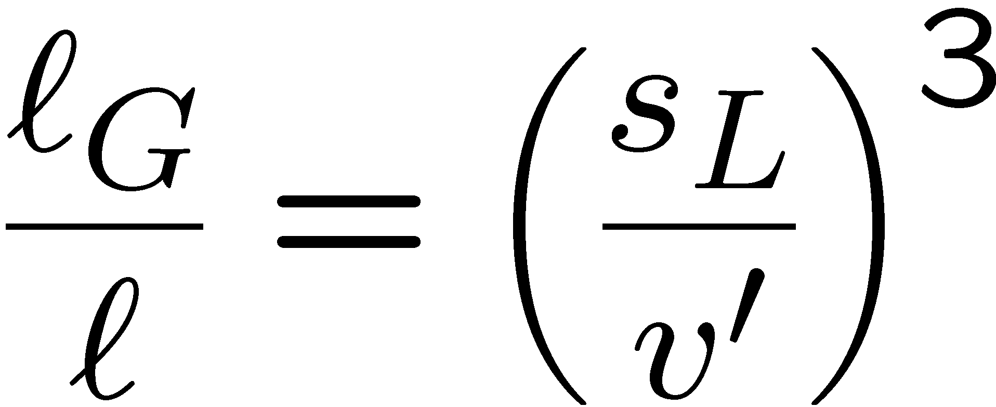
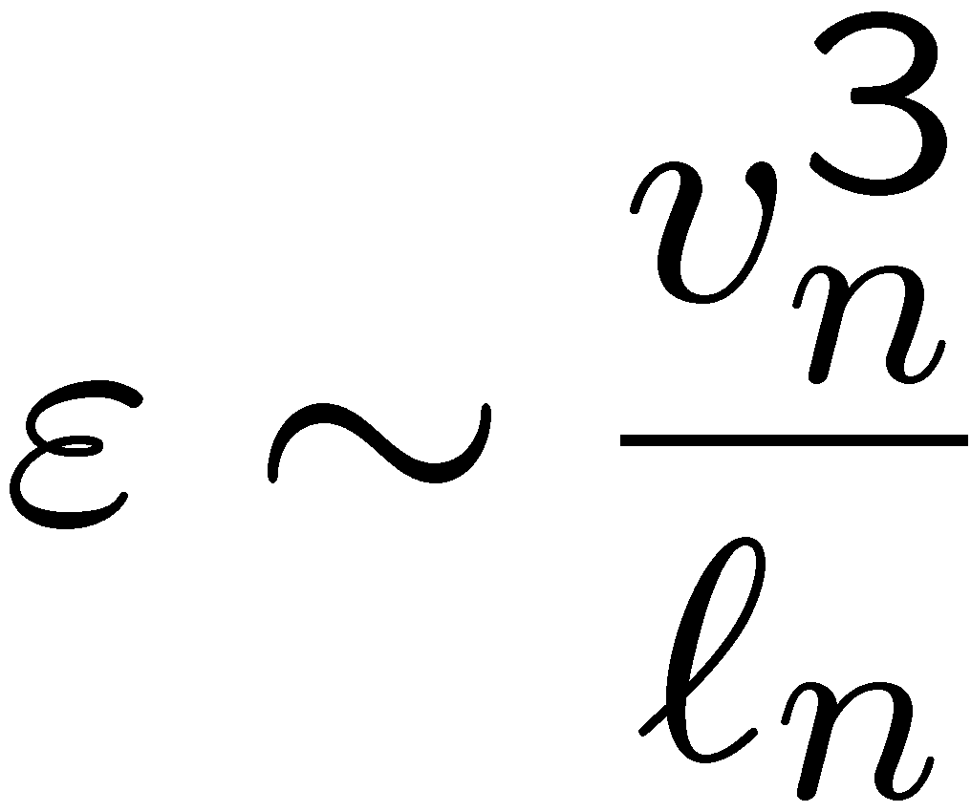
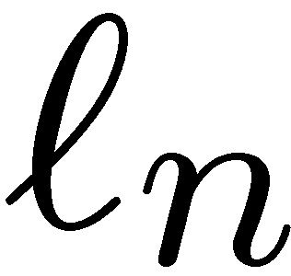
With
one may also write
The Gibson scale may be illustrated
graphically within the inertial range.
Here, following Kolmogorov scaling
in the inertial range given by
the logarithm of the velocity v_{n} is plotted over the logarithm of the length scale .
11.-18

Slide 19
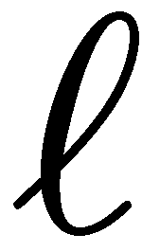
We assume v' and and thereby ε,
and also ν and thereby v_{η} and η to
be fixed.
If one enters on the vertical axis with the
burning velocity s_{L} = v_{n} into the diagram,
one obtains the Gibson scale
as the corresponding length scale on the
horizontal axis.
The laminar flame thickness , which is smaller than the Kolmogorov scale η in the corrugated flamelets regime is also shown.
11.-19

Slide 20
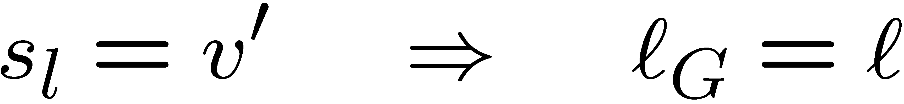
This diagram illustrates the limiting values of the Gibson scale:
If the burning velocity is equal to v', the
Gibson scale is equal to the integral
length scale:
This case corresponds to the borderline
between corrugated and wrinkled flamelets
in the regime diagram.
Conversely, if the burning velocity is equal
to the Kolmogorov velocity, the Gibson scale is equal to the Kolmogorov scale,
which corresponds to the line Ka = 1 in the regime diagram.
11.-20

Slide 21
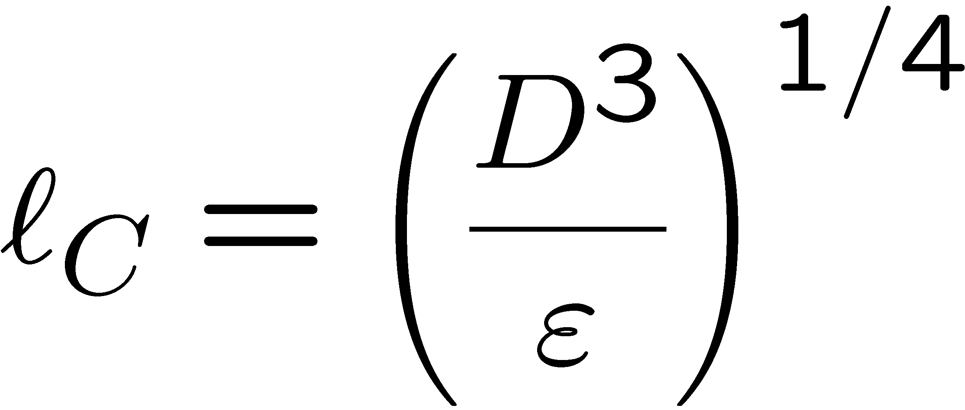
It has been shown by Peters (1992) that the Gibson scale is the lower cut-off scale of the scalar spectrum function in the corrugated flamelets regime.
At that cut-off there is only a weak change of slope in the scalar spectrum function.
This is the reason why the Gibson scale is difficult to measure.
The stronger diffusive cut-off occurs at the Obukhov-Corrsin scale defined by
Since we have assumed D = ν this scale is equal to the Kolmogorov scale.
11.-21

Slide 22
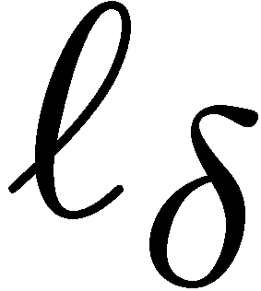
In a series of papers Mansour et al. (1992), Chen et al. (1996),
Chen and Mansour (1997) and Mansour et al. (1998) have investigated highly stretched premixed flames on a Bunsen burner which were surrounded by a large pilot.
Among the flames F1, F2 and F3 that were investigated, the flame F1 with an exit velocity of 65 m/s was close to total flame extinction which occured on this burner at 75 m/s.
11.-31

Slide 23
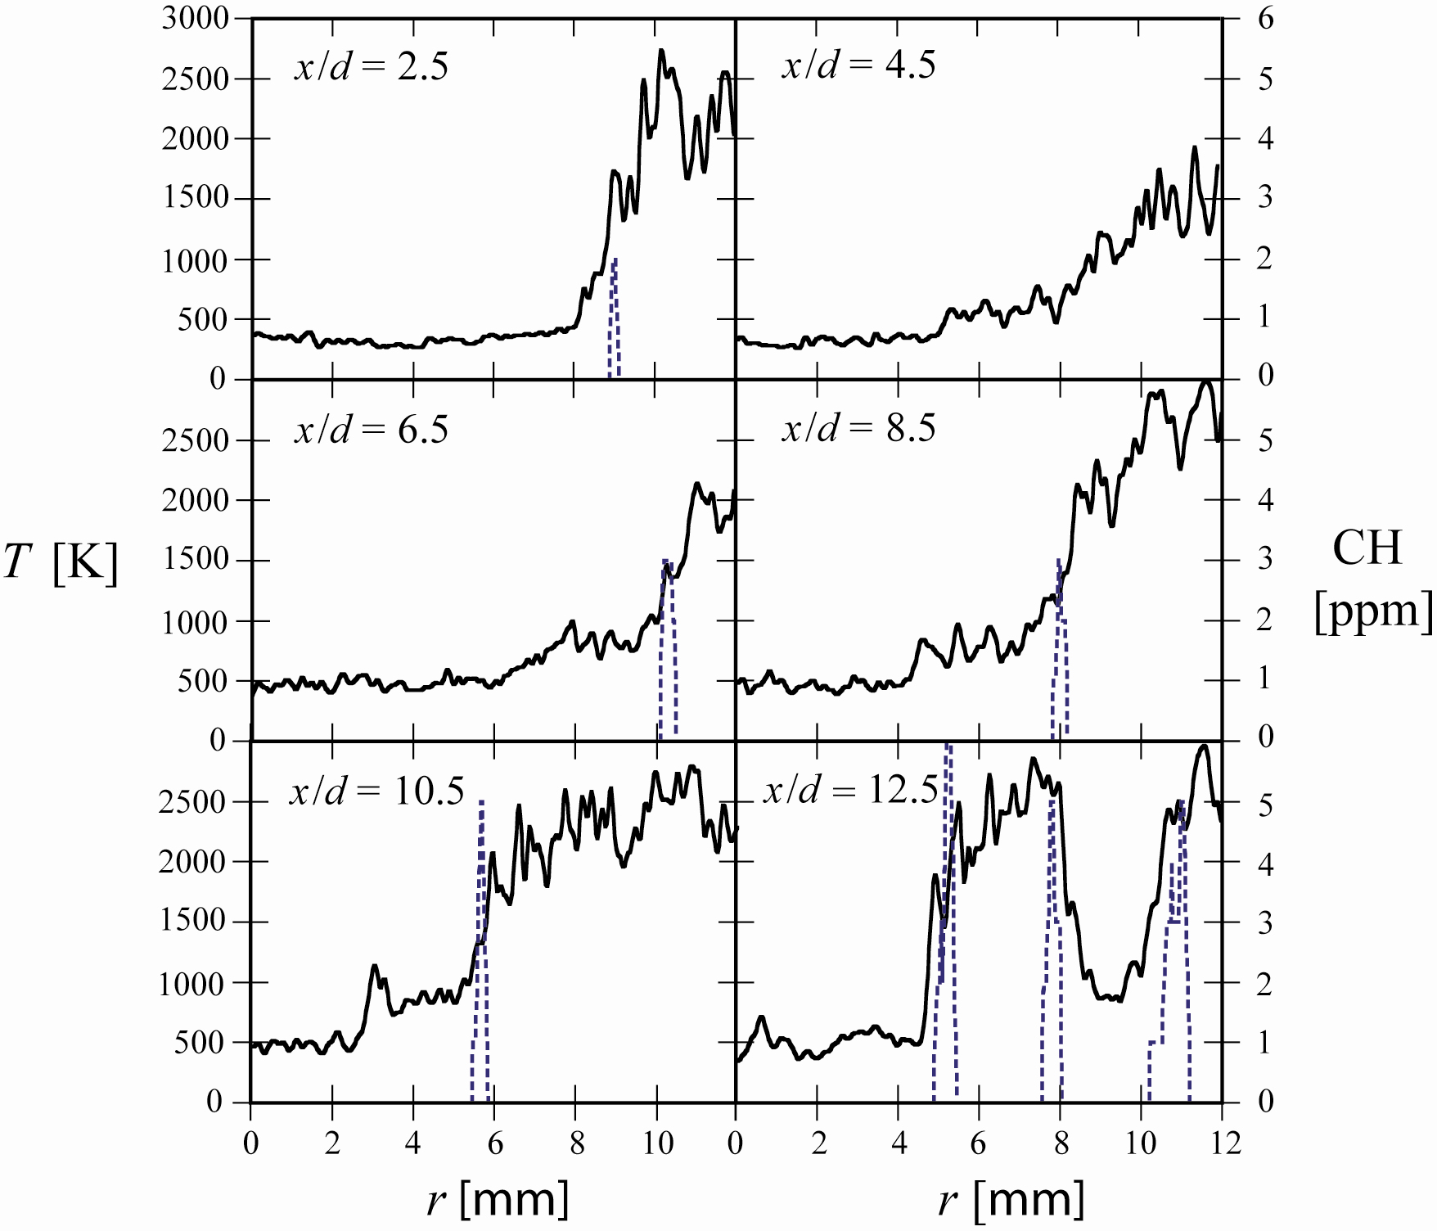
Simultaneous temperature and CH measurements
11.-32

Slide 24
They found a thin reaction zone, as deduced from the CH profile, and steep temperature gradients in the vicinity of that zone.
There also was evidence of occasional extinction of the reaction zone.
This corresponds to instantaneous shots where the CH profile was absent
as in the picture on the upper r.h.s. Such extinction events do not occur in the flame F3 which has a Karlovitz number of 23 and is located in the middle of the thin reaction zones regime.
It can be expected that local extinction events would appear more frequently, if the exit velocity is increased and the flame enters into the broken reaction zones regime.
11.-33

Slide 25
Local extinction events will occur at an exit velocity close to 75m/s so frequently that the entire flame extinguishes.
Therefore one may conclude that inthe broken reaction zones regime a premixed flame is unable to survive.
The measurements also show strong perturbations of the temperature profile on the unburnt side of the reaction zone.
This is most evident in the picture on the lower l.h.s., where the temperature reaches more than 1100 K but falls back to 800 K again.
This seems to be due to small eddies that enter into the preheat zone and confirms the concept of the thin reaction zones regime.
11.-34

Slide 26
Regimes in Premixed Combustion LES
A similar regime diagram can be constructed for LES using the filter size Δ as the
length scale and the subfilter velocity fluctuation v'_{Δ} as the velocity scale.
Such a representation introduces both physical and modeling parameters
into the diagram.
A change in the filter size, however, also leads to a change in the subfilter velocity fluctuation. This implies that the effect of the filter size, which is a numerical or model parameter, cannot be studied independently.
In response to this issue, an LES regime diagram for characterizing subfilter turbulence/flame interactions in premixed turbulent combustion was proposed by Pitsch & Duchamp de Lageneste (2002), and was recently extended by Pitsch (2005).
11.-35

Slide 27
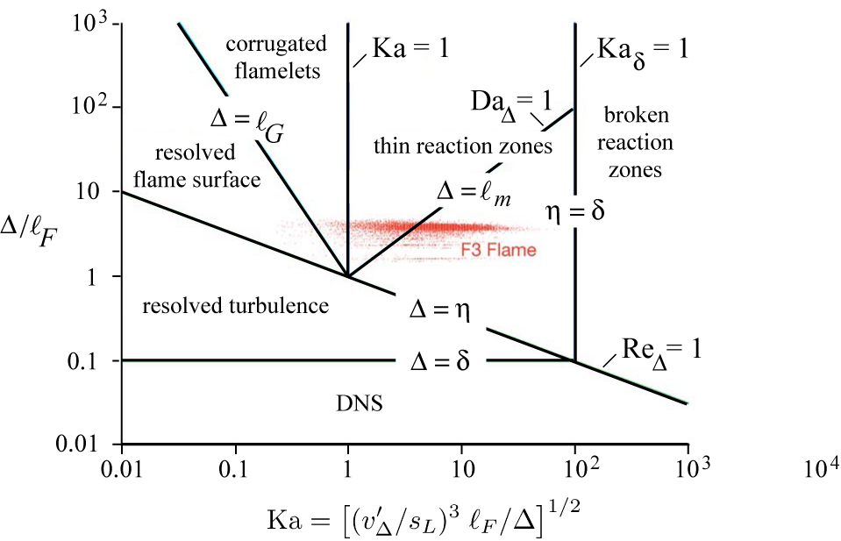
11.-36

Slide 28
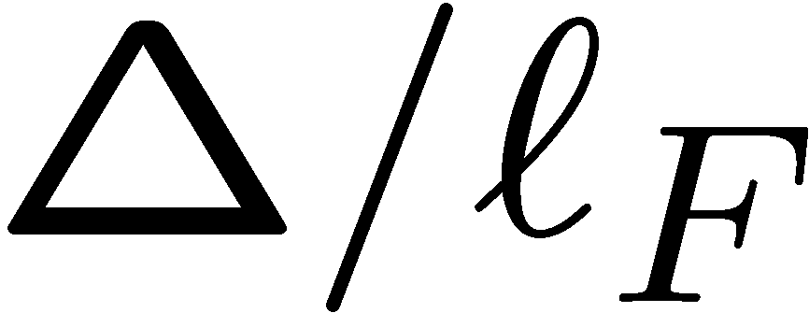
In contrast to the RANS regime diagrams, and the Karlovitz number Ka are used as the axes of the diagram.
The Karlovitz number, defined as the ratio of the Kolmogorov timescale to the chemical timescale, describes the physical interaction of flow and combustion on the smallest turbulent scales.
It is defined solely on the basis of physical quantities, and is hence independent of the filter size.
The subfilter Reynolds and Damköhler numbers and the Karlovitz number relevant in the diagram are defined as
11.-37

Slide 29
In LES, the Karlovitz number is a fluctuating quantity, but for a given flow field
and chemistry it is fixed.
The effect of changes in filter size can therefore easily be assessed at constant Ka number.
An additional benefit of this regime diagram is that it can be used equally well for DNS if Δ is associated with the mesh size.
In the following, the physical regimes are briefly reviewed and relevant issues for LES are discussed.
11.-38

Slide 30
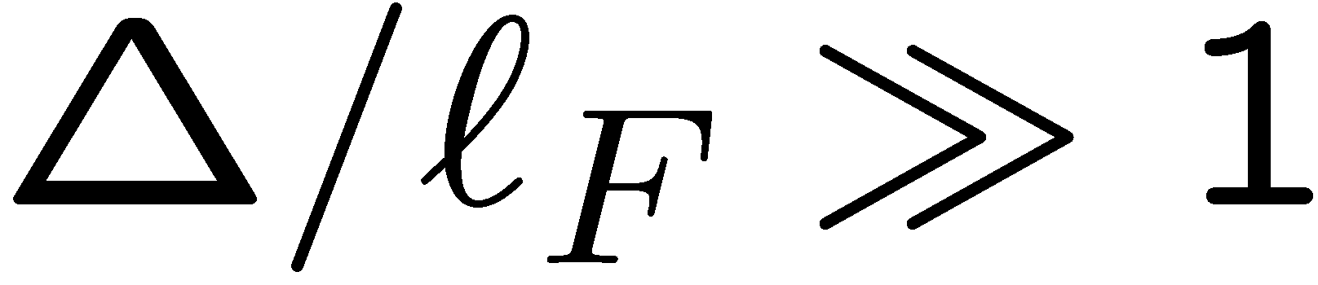
The effect of changing the LES filter width can be assessed by starting from any one
of these regimes at large ratios
As the filter width is decreased, the subfilter Reynolds number, Re_{Δ}, eventually becomes smaller than one.
Then the filter size is smaller than the Kolmogorov scale, and no subfilter modeling
for the turbulence is required.
However, the entire flame including the reaction zone is only resolved if Δ < δ.
11.-39

Slide 31
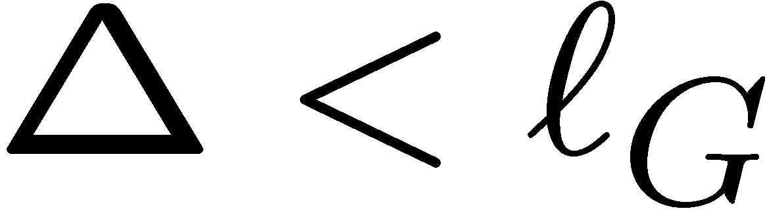
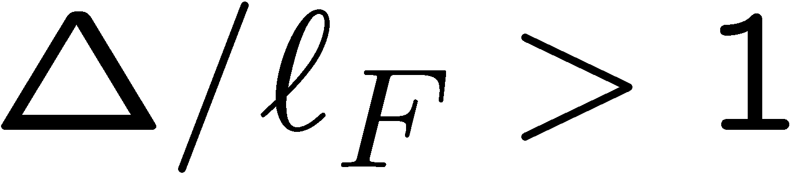
In the corrugated flamelets regime,
if the filter is decreased below the
Gibson scale,
which is the smallest scale of the
subfilter flame-front wrinkling, the
flame-front wrinkling is completely
resolved.
It is apparent that in the corrugated flamelet regime, where the flame structure is laminar, the entire flame remains on the subfilter scale, if
This is always the case for LES.
11.-40

Slide 32
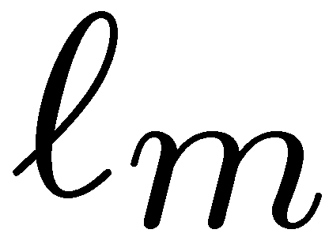
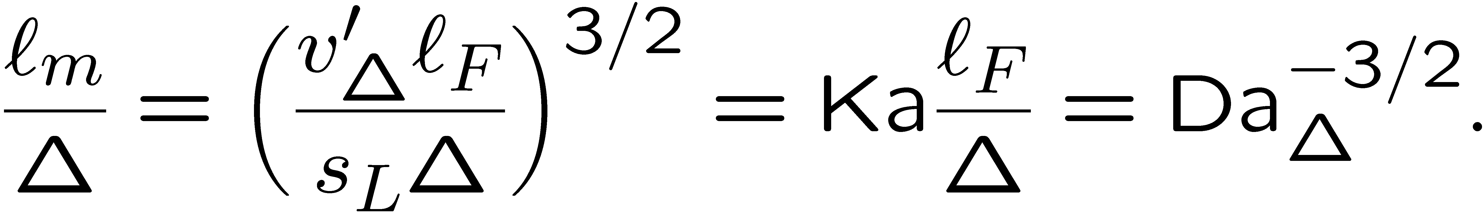
In the thin reaction zones regime, the preheat region is broadened by the turbulence.
Peters (1999) estimated the broadened flame thickness from the assumption
that the timescale of the turbulent transport in the preheat zone has to be equal to
the chemical timescale, which for laminar flames leads to the burning velocity scaling
given in the beginning of this section.
From this, the ratio of the broadened flame thickness and the filter size can be estimated as (Pitsch (2006)
Hence, the flame is entirely on the subfilter scale as long as Da_{Δ} > 1, and is partly
resolved otherwise.
11.-41

Slide 33
It is important to realize that the turbulence quantities, especially v'_{Δ}, and hence
most of the nondimensional numbers used to characterize the flame/turbulence interactions, are fluctuating quantities and can significantly change in space and time.
To give an example, the variation of these quantities from a specific turbulent stoichiometric premixed methane/air flame simulation is shown in the regime diagram.
This simulation was done for an experimental configuration with a nominal Karlowitz number of Ka = 11, based on experimentally observed integral scales.
The simulated conditions correspond to flame F3 of Chen et al. (1996), and details of the simulation can be found in Pitsch & Duchamp de Lageneste (2002).
11.-42

